Slide 1
Boolean Algebra
Digital Logic Design

Slide 2

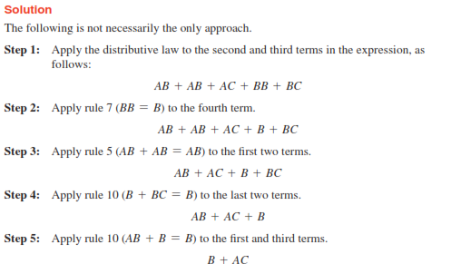
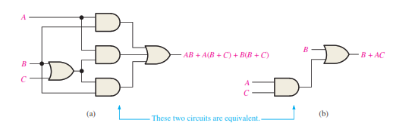
Logic Simplification Using Boolean Algebra

Slide 3

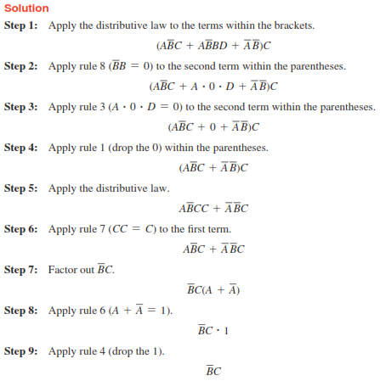
Logic Simplification Using Boolean Algebra (cont.)

Slide 4
Logic Simplification Using Boolean Algebra (cont.)
Draw the circuit of the above-mentioned equation.

Slide 5
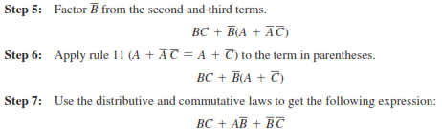
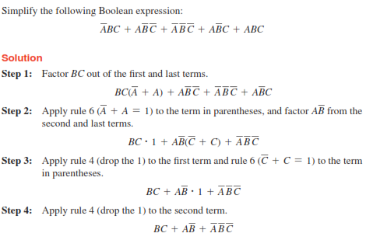
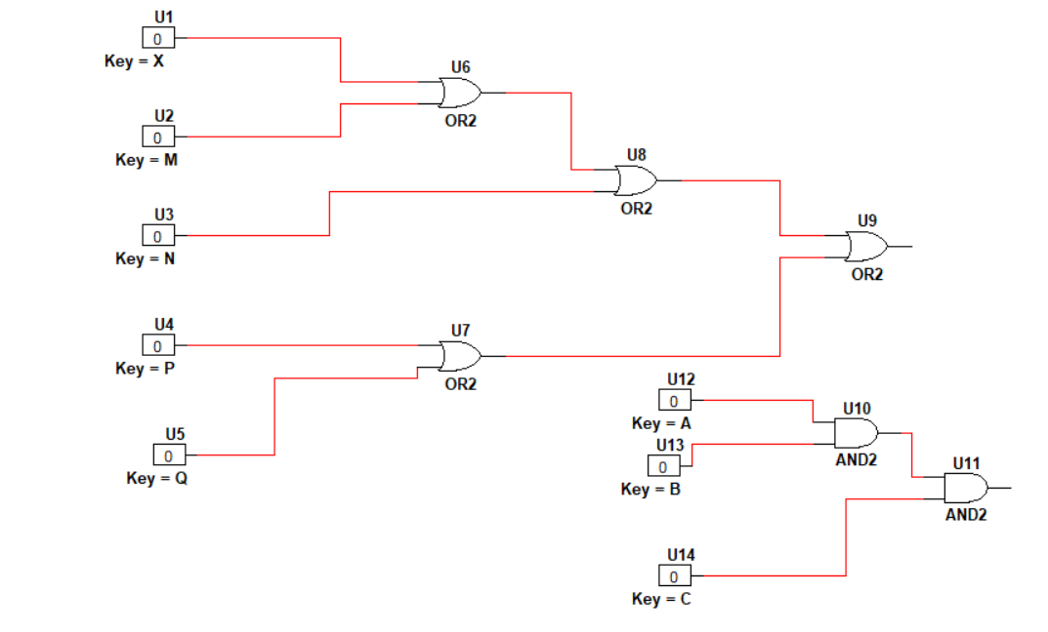
Logic Simplification Using Boolean Algebra (cont.)

Slide 6
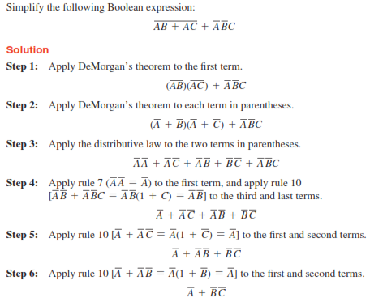
Logic Simplification Using Boolean Algebra (cont.)

Slide 7
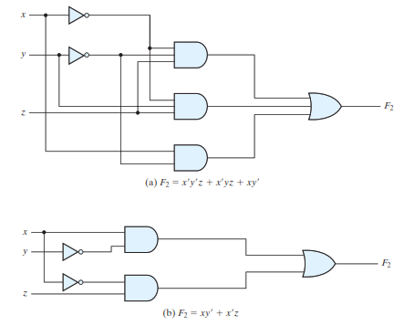

Slide 8
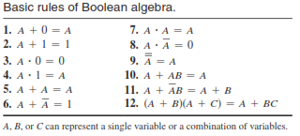

Slide 9


Logic Simplification Using Boolean Algebra (cont.)
Simplification Using Boolean Algebra
1.
2.
3.
4.
5.

Slide 10




Logic Simplification Using Boolean Algebra (cont.)
1.
2.
3.
4.
5.

